Slide 1

Selected Topics in Computational Intelligence I
Session 10
ANFIS

Slide 2
Agenda
Introduction ANFIS
ANFIS Implementation
ANFIS Architecture
ANFIS USING MATLAB (GENFIS)

Slide 3
Introduction ANFIS
ANFIS: Adaptive Neuro-Fuzzy Inference Systems
ANFIS are a class of adaptive networks that are functionally equivalent to fuzzy inference systems.
ANFIS represent Sugeno Tsukamoto fuzzy models.
ANFIS uses a hybrid learning algorithm

Slide 4
Function of ANFIS
Controller systems
Adaptive Systems

Slide 5
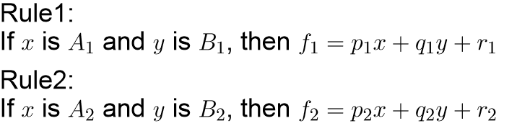
Sugeno Model
Assume that the fuzzy inference system has two inputs x And y and one output z
A first-order Sugeno fuzzy model has rules as the following:

Slide 6
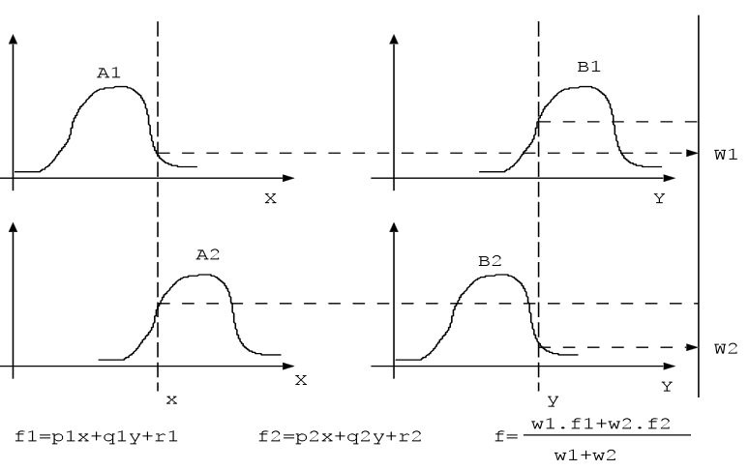
Sugeno model I

Slide 7
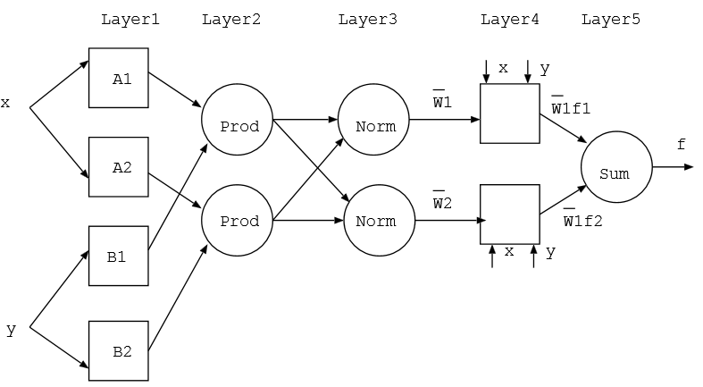
ANFIS Architecture

Slide 8
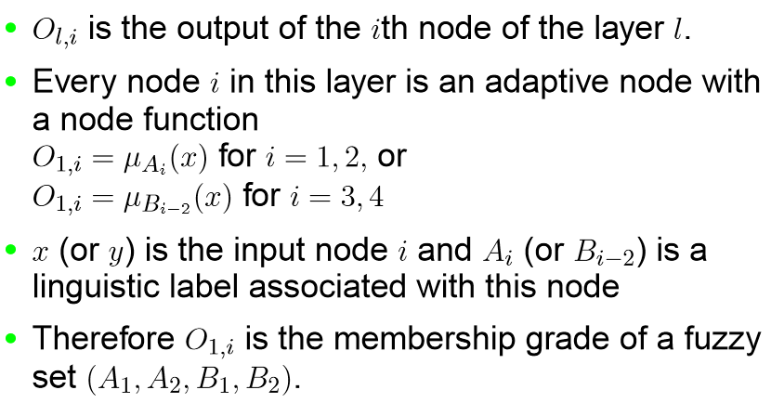
Layer 1 -I

Slide 9
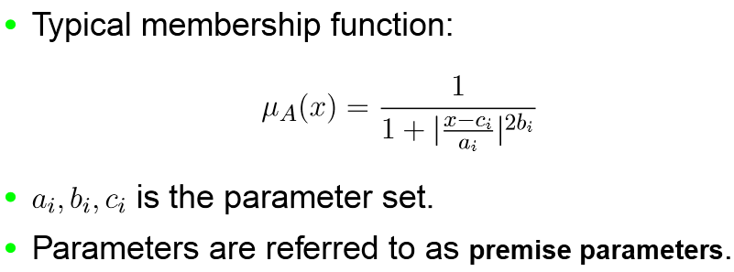
Layer 1-II

Slide 10
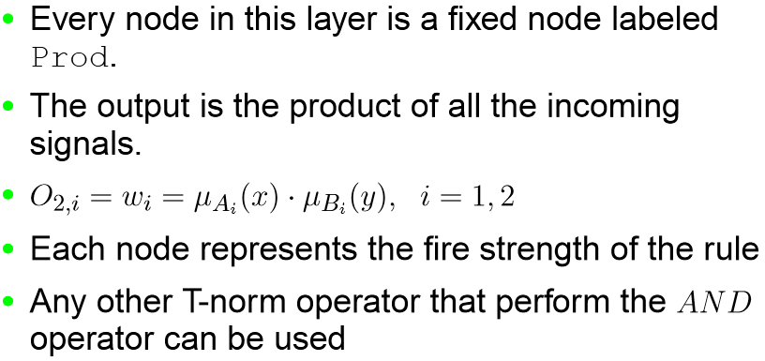
Layer 2

Slide 11
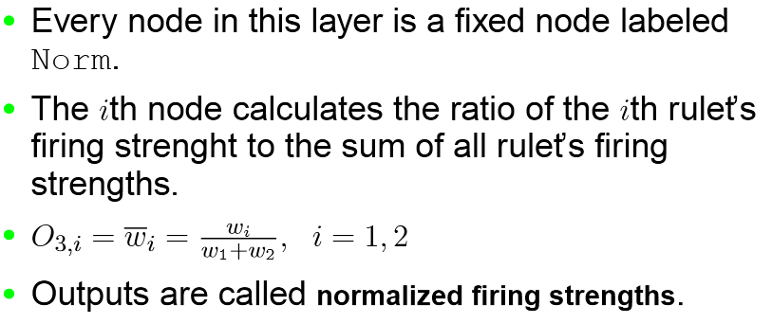
Layer 3

Slide 12
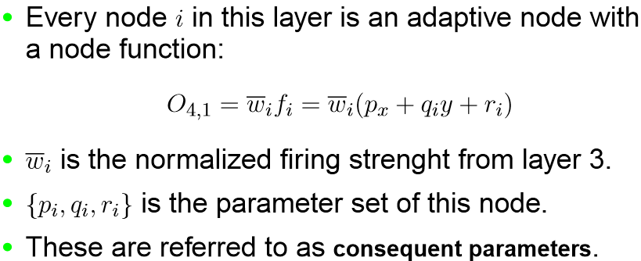
Layer 4

Slide 13
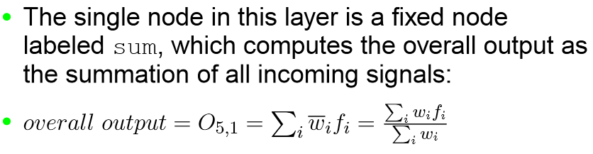
Layer 5

Slide 14
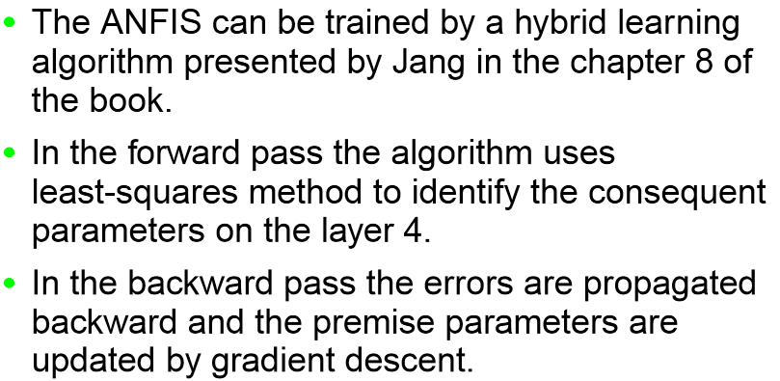
Hybrid Learning Algorithm - I

Slide 15
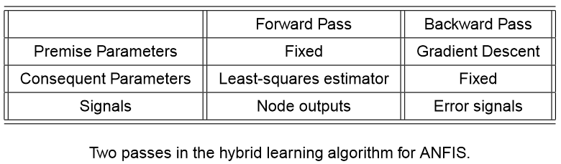
Hybrid Learning Algorithm - II

Slide 16
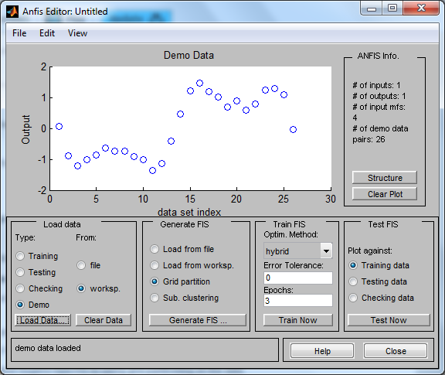
ANFIS Using MATLAB
Type anfisedit, then load data Demo

Slide 17
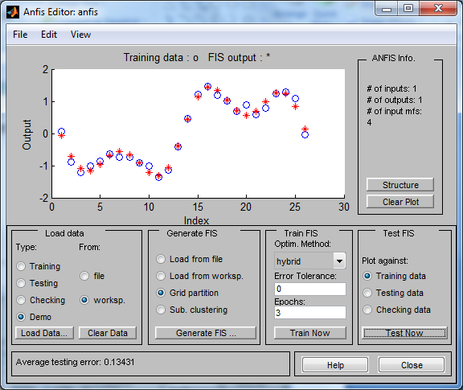

Slide 18

Predict Chaotic Time-Series
The example mgtsdemo uses anfis to predict a time series that is generated by the following Mackey-Glass (MG) time-delay differential equation.
This time series is chaotic, and so there is no clearly defined period.

Slide 19
In time-series prediction, you need to use known values of the time series up to the point in time, say, t, to predict the value at some point in the future, say, t+P.

Slide 20
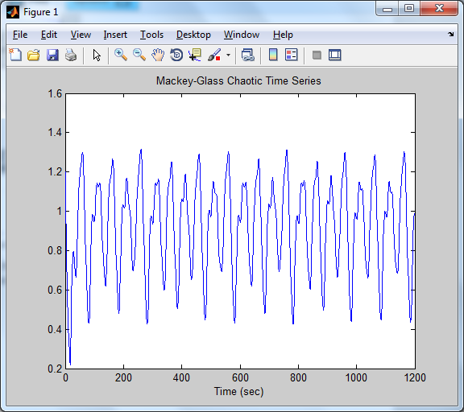
Predict Chaotic Time-Series
load mgdata.dat
time = mgdata(:, 1); x = mgdata(:, 2);
figure(1), plot(time, x);
title('Mackey-Glass Chaotic Time Series')
xlabel('Time (sec)')

Slide 21
For each t, ranging in values from 118 to 1117, the training input/output data is a structure whose first component is the four-dimensional input w, and whose second component is the output s. There is 1000 input/output data values. You use the first 500 data values for the anfis training (these become the training data set), while the others are used as checking data for validating the identified fuzzy model.

Slide 22
This division of data values results in two 500-point data structures, trnData and chkData. The following code generates this data:
for t=118:1117, Data(t-117,:)=[x(t-18) x(t-12) x(t-6) x(t) x(t+6)]; end trnData=Data(1:500, :); chkData=Data(501:end, :);

Slide 23
training
To start the training, you need a FIS structure that specifies the structure and initial parameters of the FIS for learning. The genfis1 function handles this specification.
fismat = genfis1(trnData);
The function genfis1 generates initial membership functions that are equally spaced and cover the whole input space.

Slide 24
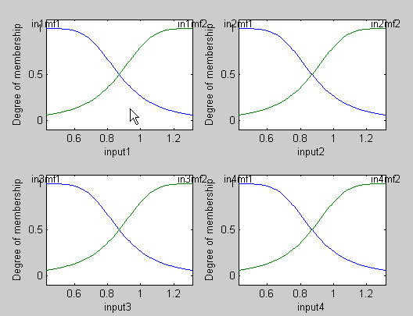
figure(2)
subplot(2,2,1)
plotmf(fismat, 'input', 1)
subplot(2,2,2)
plotmf(fismat, 'input', 2)
subplot(2,2,3)
plotmf(fismat, 'input', 3)
subplot(2,2,4) plotmf(fismat, 'input', 4)

Slide 25
To start the training, type
[fismat1,error1,ss,fismat2,error2] = ... anfis(trnData,fismat,[],[],chkData);
Because the checking data option of anfis is invoked, the final FIS you choose is the one associated with the minimum checking error.
This result is stored in fismat2. The following code plots these new membership functions.

Slide 26
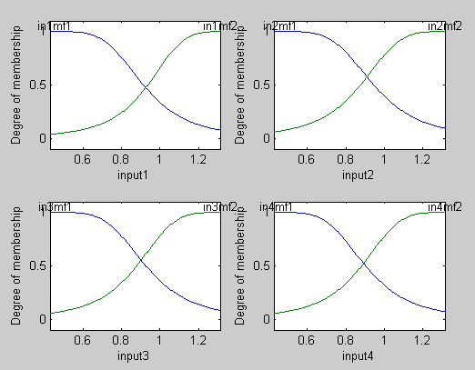
result
figure(3)
subplot(2,2,1)
plotmf(fismat2, 'input', 1)
subplot(2,2,2) plotmf(fismat2, 'input', 2)
subplot(2,2,3) plotmf(fismat2, 'input', 3)
subplot(2,2,4) plotmf(fismat2, 'input', 4)

Slide 27
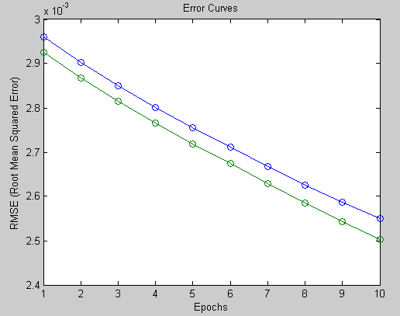
result
To plot the error signals, type
figure(4) plot([error1 error2]);
hold on; plot([error1 error2], 'o');
xlabel('Epochs');
ylabel('RMSE (Root Mean Squared Error)');
title('Error Curves');
The plots display the root-mean-square error. The plot in blue represents error1, the error for training data . The plot in green represents error2, the error for checking data .

Slide 28
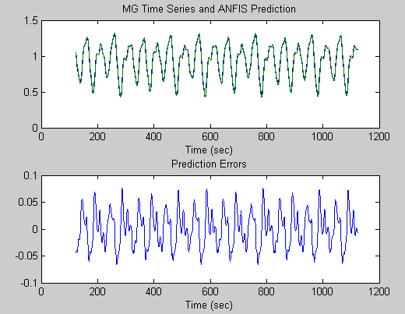
result
In addition to these error plots, you may want to plot the FIS output versus the training or checking data. To compare the original MG time series and the fuzzy prediction side by side
figure(5) anfis_output = evalfis([trnData(:,1:4); chkData(:,1:4)], ... fismat2);
index = 125:1124; subplot(211), plot(time(index), [x(index) anfis_output]);
xlabel('Time (sec)'); title('MG Time Series and ANFIS Prediction');
subplot(212), plot(time(index), x(index) - anfis_output); xlabel('Time (sec)'); title('Prediction Errors');

Slide 29
result
The difference between the original MG time series and the values estimated using anfis is very small, Thus, you can only see one curve in the first plot.
The prediction error appears in the second plot with a much finer scale. You trained for only 10 epochs. If you apply more extensive training, you get better performance.

Slide 30
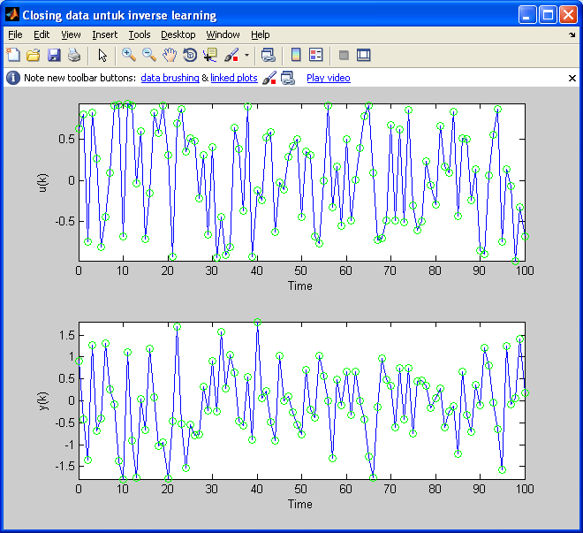
result
Data inverse learning ANFIS
plant.m:
function out = plant(y, u);
out = y*u/(1+y^2)-tan(u);

Slide 31
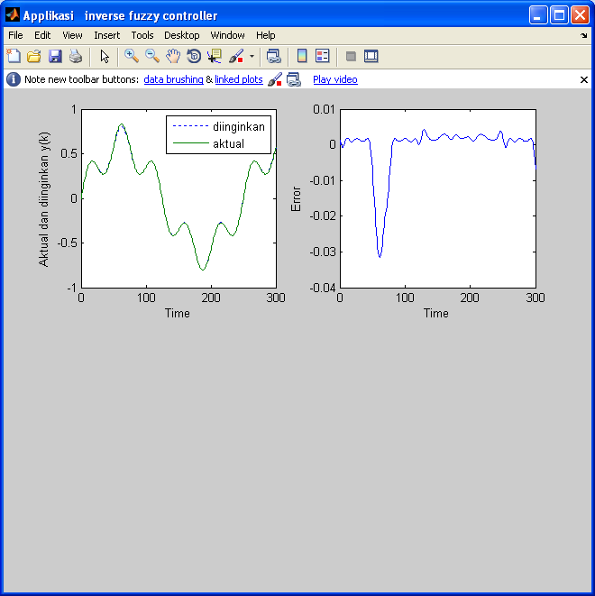
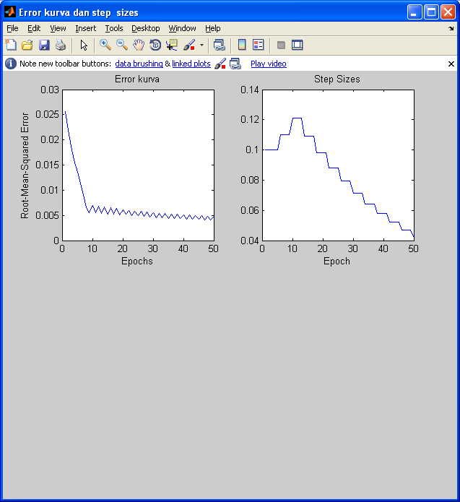
result
Error curve and step sizes
Hasil kontroler ANFIS

Slide 32
Implementation
Currency prediction
Robot controller
Face tracking

Slide 33
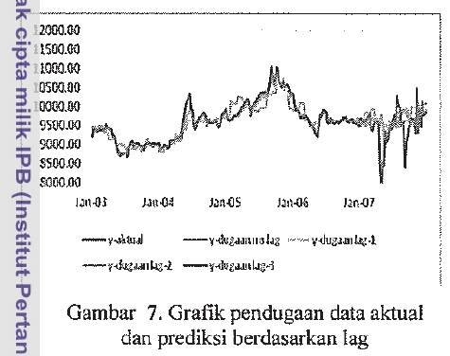
Implementation

Slide 34
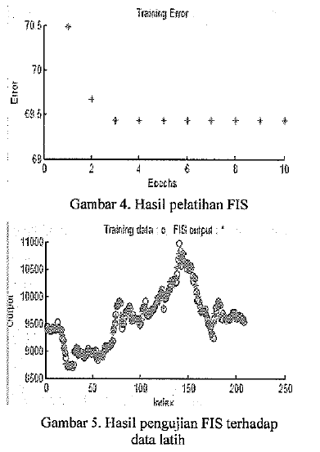

Slide 35
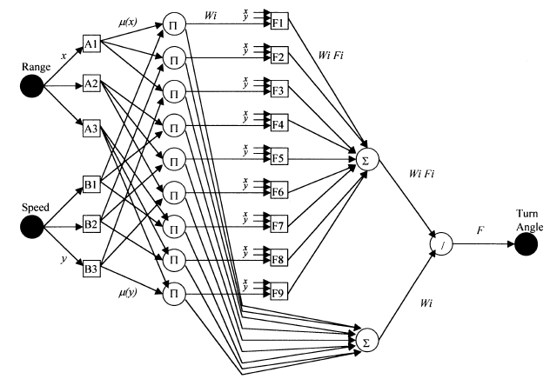
Implementation
Robot controller

Slide 36
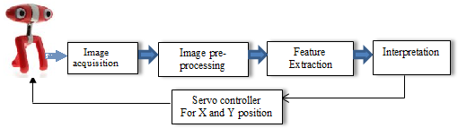
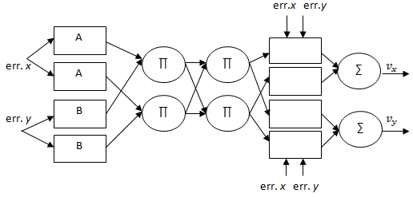
Face Tracking using ANFIS
Using pan tilt camera

Slide 37
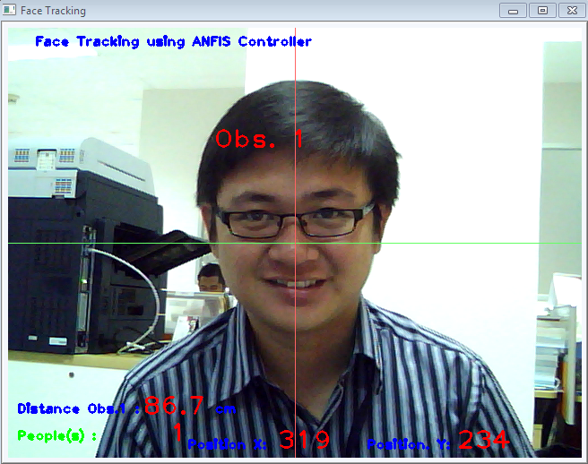
Face Tracking using ANFIS

Slide 38
References
Adries P. Engelbrect. (2007), Computational Intelligence An Introduction. 2nd ed. John Wiley & Sons. USA.
Widodo Budiharto (2014), Modern Robotics with OpenCV, SPG Publisher, USA.
http://www.mathworks.com/products/fuzzy-logic/

Slide 39
Thank You

